Slide 1

DIGITAL

Slide 2
An Introduction to
HTML

Slide 3
Agenda
What is HTML ?
Document Structure
HTML elements
Basic HTML tags
Classes and Ids
HTML and form elements
HTML Tables

Slide 4
What is HTML?
1. HTML abbreviated for Hyper Text Markup Language
2. A markup language is a set of markup tags
3. Each HTML tag describes different document content
4. HTML tags normally come in pairs like <p> and </p>

Slide 5
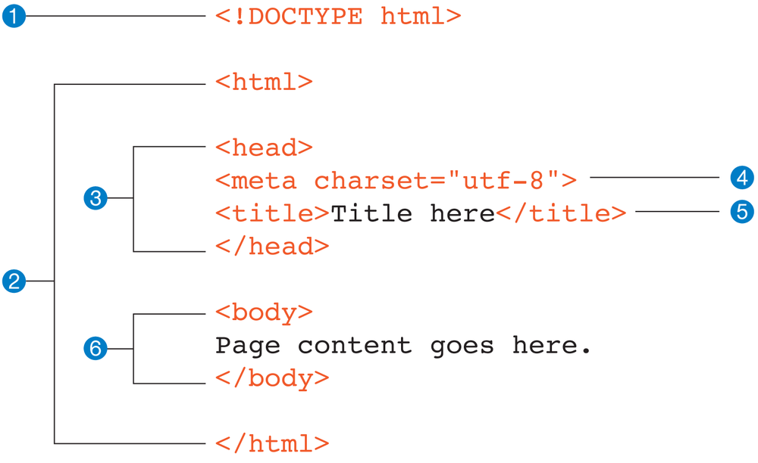
Document Structure

Slide 6
How it looks in browser?
Demo

Slide 7
Elements inside BODY element
HTML elements are written with a start tag, with an end tag, with the content in between:
Syntax :: <tagname>element content</tagname>
<p>MY First Paragraph.</p>
<div>My Container</div>
<h1>Heading1</h1>
The elements which has not the end tag are called self-closing tags , as - <br />, <hr/>, <img />,<input />

Slide 8
Basic HTML tags
Headings tags
Paragraph tag
Hyperlink tag
Order list and Unordered list tags
Miscellaneous tag

Slide 9
HTML Headings
Headings are defined with the <h1> to <h6> tags.
<h1> defines the most important heading. <h6> defines the least important heading.
Samples of the six heading types:
<H1>Level-1 (H1)</H1>
<H2 >Level-2 (H2)</H2>
<H3>Level-3 (H3)</H3>
<H4 >Level-4 (H4)</H4>
<H5>Level-5 (H5)</H5>
<H6>Level-6 (H6)</H6>

Slide 10
HTML Paragraphs
The HTML <p> element defines a paragraph.
Example:
<p>This is a paragraph</p>
<p>This is another paragraph</p>

Slide 11
HTML Links - Hyperlinks
HTML links are hyperlinks.
A hyperlink is a text or an image you can click on, and jump to another document.
Example:
<a href="url">link text</a>
<a href=" url ">
<img src="smiley.gif" alt="HTML tutorial" style="width:42px;height:42px;border:0">
</a>

Slide 12
HTML Lists
Example of an unordered list and an ordered list in HTML:
Unordered List:
<ul>
<li> First item </li> o First item
<li> Second item </li> o Second item
<li> Third item </li> o Third item
</ul>
Ordered List:
<ol>
<li> First item </li> 1. First item
<li> Second item </li> 2. Second item
<li> Third item </li> 3. Third item
</ol>

Slide 13
Miscellaneous
STRONG – The HTML Strong Element (<strong>) gives text strong importance, and is typically displayed in bold.
HR - The <hr> element is used to separate content in an HTML page.
BR - The <br> tag inserts a single line break.
SPAN - The <span> tag is used to group inline-elements in a document.
DIV -The <div> tag defines a division or a section in an HTML document and is used to group block-elements to format them with CSS.

Slide 14
Classes and Ids
You should only give elements an ID attribute if they are unique. They should be applied to that element only and nothing else.
Classes can be applied to multiple elements that share the same style properties. Things that should look and work in the same way can have the same class name.
Example: <ul id="categories">
<li class="item">Category 1</li>
<li class="item">Category 2</li>
<li class="item">Category 3</li>
</ul>

Slide 15
Block-level and Inline-level Elements
There are two types of elements in HTML page – INLINE and BLOCK.
A block-level element always starts on a new line and takes up the full width available (stretches out to the left and right as far as it can).
The <div> element is a block-level element.
An inline element does not start on a new line and only takes up as much width as necessary.
This is an inline <span> element inside a paragraph.
Demo

Slide 16
HTML Form Elements
The most important form element is the <input> element.
Type of an input element decided by its “type” attribute
Some basic input types :
- text input - <input type=“text” />
- password input - <input type=“password” />
- email input - <input type=“email” />
- checkbox input - <input type=“checkbox” />
- radio input - <input type=“radio” />
- submit button - <input type=“submit” />

Slide 17
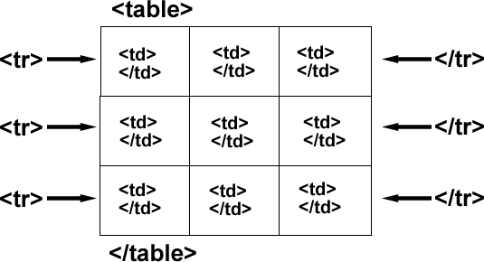
HTML Tables
Tables are defined with the <table> tag.
Tables are divided into table rows with the <tr> tag.
Table rows are divided into table data with the <td> tag.
A table row can also be divided into table headings with the <th> tag.

Slide 18
Example
<table style="width:100%">
<tr>
<th>Lastname</th>
<th>Points</th>
</tr>
<tr>
<td>Smith</td>
<td>50</td>
</tr>
<tr>
<td>Jackson</td>
<td>94</td>
</tr>
</table>

Slide 19
An Introduction to
CSS

Slide 20
Agenda
What is CSS?
Type of CSS
Selectors
Id and Class
CSS Properties

Slide 21
What is CSS?
CSS stands for Cascading Style Sheets
CSS is used to define styles for your web pages, including the design, layout and variations in display for different devices and screen sizes.
control layout of many documents from one single style sheet;

Slide 22
Type of CSS
There are three types of CSS
1. Inline CSS
2. Embedded CSS
3. External Style CSS

Slide 23
Inline Style
<p style="color: #ff0000;">Some red text</p>
External Style Sheet
<head>
<title><title>
<link rel="stylesheet" type="text/css" href="style.css" />
</head>
Embedded Style
<head>
<title><title>
<style type="text/css">
.alternate{background:#ff0000;}
#alternate{background:#ff0000;}
</style>
</head>

Slide 24
Selectors
In CSS, selectors are patterns used to select the element(s)
You want to style.
selector { property: value }
body {background: #eeeeee; font-family: Georgia, sans-serif;}
h1 {font-family: Georgia, sans-serif;}
h1, h2 {color: #009900;font-family: Georgia, sans-serif;}

Slide 25
Id and Class
ID's are unique
Each element can have only one ID
Each page can have only one element with that ID
Classes are NOT unique
You can use the same class on multiple elements.
You can use multiple classes on the same element.
Syntax:
#id {property: value}
.class {property: value}

Slide 26
Padding and Margin
padding-top:10px;
padding-right:10px;
padding-bottom:10px;
padding-left:10px;
Or
padding:10px;
margin-top:10px;
margin-right:10px;
margin-bottom:10px;
margin-left:10px;
Or
margin:10px;
In-Short: padding /margin: top-gap px , right-gap px ,bottom-gap px ,left-gap px

Slide 27
Padding, Margin and Border
I appreciate the prompt delivery of
the pack of star disks.
padding
border
margin

Slide 28
Display Property
display is CSS's most important property for controlling
layout. Every element has a default display value depending
on what type of element it is.
display: block;
display: inline;
display: inline-block;
display: none;

Slide 29
Color
Colors are displayed combining RED, GREEN, and BLUE light.
color: value;
#container {
Width: 70px;
Height:200px;
padding: 30px;
border: 1px solid #666;
color: #ffffff; }

Slide 30
Text Align
The text-align CSS property describes how inline content
like text is aligned in its parent block element. text-align does
not control the alignment of block elements, only their
inline content.
Syntax:
text-align: value;
text-align: left;
text-align: right;
text-align: center;
text-align: justify;

Slide 31
Clear and float
Clear:both;
Clear:left;
Clear:right;
Float:left;
Float:right;

Slide 32
Text Decoration
text-decoration: none
text-decoration: underline
Font -Family, Font Size
font-family: Verdana, sans-serif;
font-size: 15px;
Font Weight
font-weight: Value
font-weight: bold;
font-weight: normal;
font-weight: numbers; (300, 400, 600, 800)

Slide 33
Link
<a href="" title="">some link text</a>
a {color: #009900;}
a:visited {color: #999999;}
a:hover {color: #333333;}
a:focus {color: #333333;}
a:active {color: #009900;}

Slide 34
Background and border
background: #ffffff;
background: url(path of image);
background: #ffffff url(path of image)
border: 1px solid #333333;
border-top: 1px solid #333333;
border-right: 1px solid #333333;
border-bottom: 1px solid #333333;
border-left: 1px solid #333333;

Slide 35
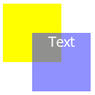
Position and z-index
position: absolute;
position: relative;
position: fixed;
position: static;
z-index: 1;
.yellow-box{position: relative; z-index: 1;}
.blue-box{position: relative; z-index: 2;}

Slide 36
Exercise
Q1. Print two lists with any information you want. One list should be an ordered list, the other list should be an unordered list.
Q2. Print your name to the screen with every letter being a different heading size.
Q3. Create some links to various search engines (google, yahoo, etc)
Q4. Create a page with a link at the top of it that when clicked will jump all the way to the bottom of the page. At the bottom of the page there should be a link to jump back to the top of the page.

Slide 37
Q5. Display five different images. Skip two lines between each image. Each image should have a title.
Q6. Display an image that has a border of size 2, a width of 200, and a height of 200.
Q7. Display an image that when clicked will link to a search engine of your choice (should be opened in a new window).
Q8. Display an image that when clicked will link to itself and will display the image in the browser by itself.
Q9. Print a paragraph with 4 - 5 sentences in green with Tahoma font.

Slide 38
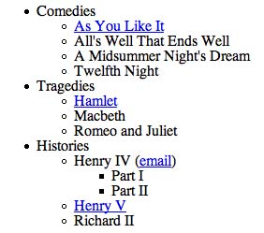
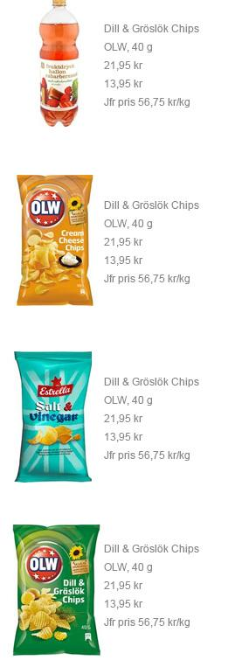
Q10. Create lists like below using HTML and CSS.

Slide 39
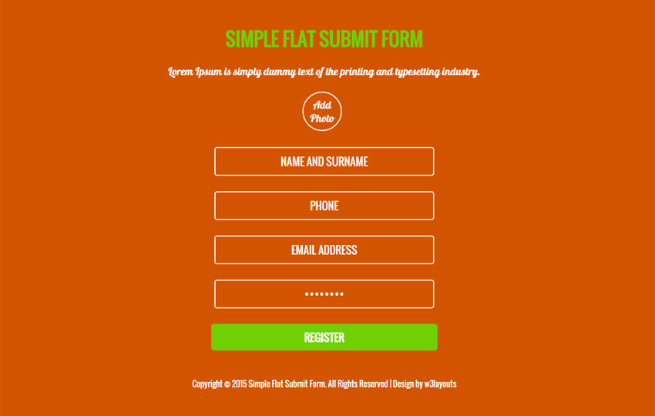
Q11. Create a simple form using HTML and CSS.

Slide 40
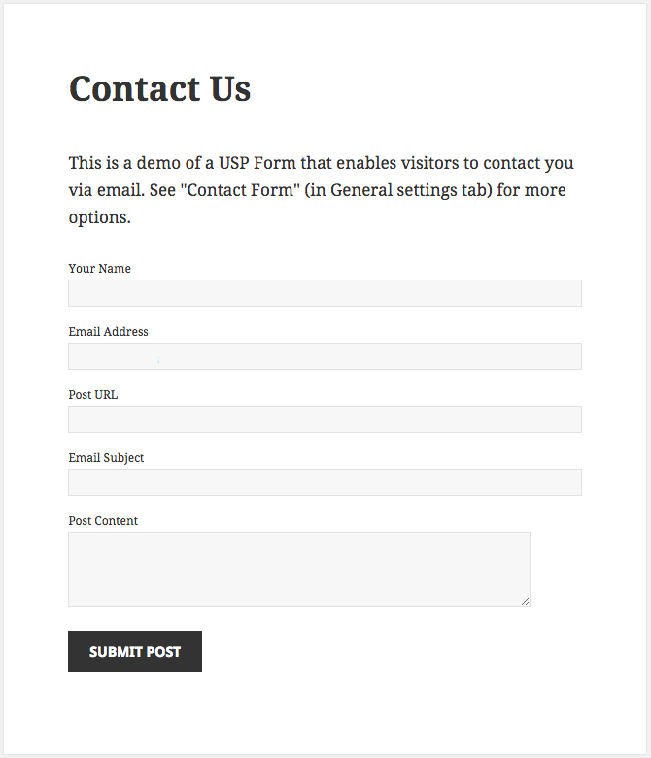
Q12. Create a Contact Us page.

